Slide 1
Organizational Behavior 15th Ed
Chapter 12
Robbins and Judge
Leadership

Slide 2
Chapter 12 Learning Objectives
After studying this chapter you should be able to:
Define leadership and contrast leadership and management.
Summarize the conclusions of trait theories of leadership.
Identify the central tenets and main limitations of behavioral theories.
Assess contingency theories of leadership by their level of support.
Compare and contrast charismatic and transformational leadership.
Define authentic leadership and show why effective leaders exemplify ethics and trust.
Demonstrate the role mentoring plays in our understanding of leadership.
Address challenges to the effectiveness of leadership.

Slide 3
Define leadership and contrast leadership and management
LO 1
Leadership is the ability to influence a group toward the achievement of a vision or set of goals.
Not all leaders are managers nor are all managers leaders.
Nonsanctioned leadership is often as important or more important than formal influence.
1

Slide 4
Define leadership and contrast leadership and management
LO 1
Strong leadership and strong management are needed for optimal effectiveness.
Leaders are needed today to challenge the status quo, create visions of the future, and inspire organizational members to want to achieve the visions.
Managers formulate detailed plans, create efficient organizational structures, and oversee day-to-day operations.
1

Slide 5
Summarize the conclusions of trait theories of leadership
LO 2
Trait theories of leadership focus on personal qualities and characteristics.
The search for personality, social, physical, or intellectual attributes that differentiate leaders from nonleaders goes back to the earliest stages of leadership research.
1

Slide 6
Summarize the conclusions of trait theories of leadership
LO 2
A breakthrough, of sorts, came when researchers began organizing traits around the Big Five personality framework (see Chapter 5).
Most of the dozens of traits in various leadership reviews fit under one of the Big Five (ambition and energy are part of extraversion, for instance), giving strong support to traits as predictors of leadership.
1

Slide 7
Summarize the conclusions of trait theories of leadership
LO 2
The trait approach does have something to offer.
Leaders who like being around people and are able to assert themselves (extraverted), who are disciplined and able to keep commitments they make (conscientious), and who are creative and flexible (open) do have an apparent advantage when it comes to leadership, suggesting good leaders do have key traits in common.
1

Slide 8
Summarize the conclusions of trait theories of leadership
LO 2
Another trait that may indicate effective leadership is emotional intelligence (EI).
Advocates of EI argue that without it, a person can have outstanding training, a highly analytical mind, a compelling vision, and an endless supply of terrific ideas but still not make a great leader.
A core component of EI is empathy.
1

Slide 9
Summarize the conclusions of trait theories of leadership
LO 2
Conclusions based on the latest findings.
Contrary to what we believed 20 years ago and thanks to the Big Five, we can say that traits can predict leadership.
Traits do a better job predicting the emergence of leaders and the appearance of leadership than actually distinguishing between effective and ineffective leaders.
1

Slide 10
Identify the central tenets and main limitations of behavioral theories
LO 3
Ohio State Studies found two behaviors that accounted for leadership behavior
Initiating structure-the extent to which a leader is likely to define and structure his or her role and those of employees in the search for goal attainment.
Consideration is the extent to which a person’s job relationships are characterized by mutual trust, respect for employees’ ideas, and regard for their feelings.
1

Slide 11
Identify the central tenets and main limitations of behavioral theories
LO 3
University of Michigan’s objectives also came up with two behavioral dimensions
The employee-oriented leader emphasized interpersonal relationships by taking a personal interest in the needs of employees and accepting individual differences among them.
The production oriented leader emphasized the technical or task aspects of the job, focusing on accomplishing the group’s tasks.
1

Slide 12
Identify the central tenets and main limitations of behavioral theories
LO 3
The GLOBE study suggests there are international differences in preference for initiating structure and consideration.
Based on the values of Brazilian employees, a U.S. manager leading a team in Brazil would need to be team oriented, participative, and humane.
Leaders high in consideration would succeed best in this culture.
1

Slide 13
Identify the central tenets and main limitations of behavioral theories
LO 3
Summary of Trait Theories and Behavioral Theories
Leaders who have certain traits and who display consideration and structuring behaviors do appear to be more effective.
As important as traits and behaviors are in identifying effective or ineffective leaders, they do not guarantee success.
The context matters, too.
1

Slide 14
Assess contingency theories of leadership by their level of support
LO 4
Contingency Theory-Fiedler Model
Key factor is individual’s leadership style
Task or Relationship oriented
Assumes leadership style is fixed
1

Slide 15
Assess contingency theories of leadership by their level of support
LO 4
Contingency Theory-Fiedler Model
Define the situation
Contingency dimensions
Leader-member relations
Task structure
Position power
1

Slide 16
Assess contingency theories of leadership by their level of support
LO 4
Contingency Theory-Fiedler Model
Evaluate the situation
Leader-member relations-good or bad
Task structure- high or low
Position power-strong or weak
1

Slide 17
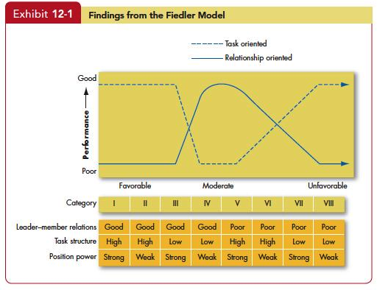
Assess contingency theories of leadership by their level of support
LO 4
1

Slide 18
Assess contingency theories of leadership by their level of support
LO 4
Evaluation of Fiedler
There is considerable evidence to support at least substantial parts of the model.
There are problems with the practical use of the model that need to be addressed.
1

Slide 19
Assess contingency theories of leadership by their level of support
LO 4
Situational Leadership Theory
Situational leadership is a contingency theory that focuses on the followers.
Successful leadership is achieved by selecting the right leadership style, which is contingent on the level of the followers’ readiness.
1

Slide 20
Assess contingency theories of leadership by their level of support
LO 4
Path-Goal Theory
One of the most respected approaches to leadership is the path-goal theory developed by Robert House.
It is a contingency model of leadership that extracts key elements from the Ohio State leadership research on initiating structure and consideration and the expectancy theory of motivation.
1

Slide 21
Assess contingency theories of leadership by their level of support
LO 4
According to path-goal theory, whether a leader should be directive, supportive, or should demonstrate some other behavior depends on complex analysis of the situation.
Supportive leadership results in high performance and satisfaction when employees are performing structured tasks.
Directive leadership is likely to be perceived as redundant among employees with high ability or considerable experience.
1

Slide 22
Assess contingency theories of leadership by their level of support
LO 4
Testing path-goal theory has not been easy.
Evidence found mixed support for the proposition that removing obstacles is a component of effective leadership.
Another review found the lack of support “shocking and disappointing.”
Others argue adequate tests of the theory have yet to be conducted.
1

Slide 23
Assess contingency theories of leadership by their level of support
LO 4
Victor Vroom and Phillip Yetton’s leader-participation model relates leadership behavior and participation in decision-making.
Like path-goal theory, it says leader behavior must adjust to reflect the task structure.
The model is normative—it provides a decision tree of seven contingencies and five leadership styles for determining the form and amount of participation in decision-making.
1

Slide 24
Assess contingency theories of leadership by their level of support
LO 4
Research testing both the original and revised leader-participation models has not been encouraging, although the revised model rates higher in effectiveness.
Criticism focuses on the model’s complexity and the variables it omits.
1

Slide 25
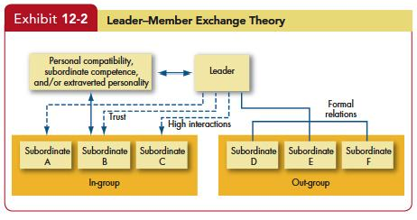
Assess contingency theories of leadership by their level of support
LO 4
1

Slide 26
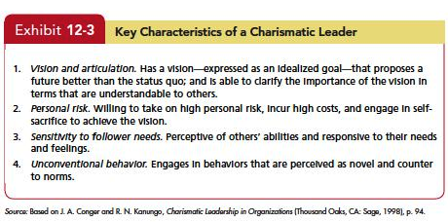
Compare and contrast charismatic and transformational leadership
LO 5
1

Slide 27
Compare and contrast charismatic and transformational leadership
LO 5
Training individuals for charismatic behavior.
A three-step process is suggested.
Develop the aura of charisma by maintaining an optimistic view; using passion as a catalyst for generating enthusiasm; and communicating with the whole body, not just with words.
Creating a bond that inspires others to follow.
Brings out the potential in followers by tapping into their emotions.
1

Slide 28
Compare and contrast charismatic and transformational leadership
LO 5
The Dark Side of Charismatic Leadership
Don’t necessarily act in interest of organizations.
Many have allowed their personal goals to override the goals of the organization.
Research has shown that individuals who are narcissistic are also higher in some behaviors associated with charismatic leadership.
Some charismatic leaders are too successful convincing followers to pursue a vision that can be disastrous.
1

Slide 29
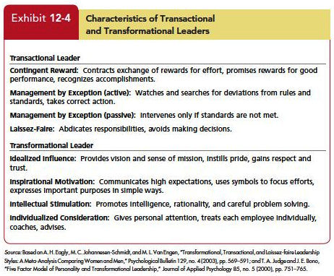
Compare and contrast charismatic and transformational leadership
LO 5
Transactional Leaders: Leaders who guide or motivate their followers in the direction of established goals by clarifying role and task requirements
Transformational Leadership: Leaders who inspire followers to transcend their own self-interests and who are capable of having a profound and extraordinary effect on followers.
1

Slide 30
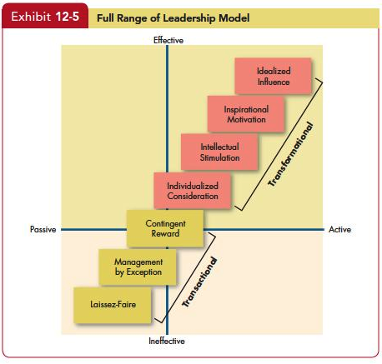
Compare and contrast charismatic and transformational leadership
LO 5
1

Slide 31
Compare and contrast charismatic and transformational leadership
LO 5
How Transformational Leadership works:
Creativity, theirs and others.
Decentralization of responsibility.
Propensity to take risks.
Compensation is geared toward long-term results.
Greater agreement among top managers about the organization’s goals.
Increase follower self-efficacy, giving the group a “can do” spirit.
1

Slide 32
Compare and contrast charismatic and transformational leadership
LO 5
Transformational leadership has been impressively supported at diverse job levels and occupations (school principals, teachers, marine commanders, ministers, presidents of MBA associations, military cadets, union shop stewards, sales reps).
1

Slide 33
Compare and contrast charismatic and transformational leadership
LO 5
Transformational leadership isn’t equally effective in all situations.
It has a greater impact on the bottom line in smaller, privately held firms than in more complex organizations.
It may be more effective when leaders can directly interact with the workforce and make decisions than when they report to an external board of directors or deal with a complex structure.
1

Slide 34
Compare and contrast charismatic and transformational leadership
LO 5
The GLOBE study—of 18,000 leaders from 825 organizations in 62 countries—links a number of elements of transformational leadership with effective leadership, regardless of country.
This conclusion is very important because it disputes the contingency view that leadership style needs to adapt to cultural differences.
1

Slide 35
Define authentic leadership and show why effective leaders exemplify ethics and trust
LO 6
Authentic Leadership
Leaders know who they are
Know what they believe in and value
Act on those values and beliefs openly and candidly
1

Slide 36
Define authentic leadership and show why effective leaders exemplify ethics and trust
LO 6
Ethics and Leadership
Transformational leaders foster moral virtue when they try to change the attitudes and behaviors of followers.
Unethical leaders use their charisma to enhance power over followers, directed toward self-serving ends.
An example, when leaders give themselves large bonuses while they seek to cut costs by laying off long-time employees.
1

Slide 37
Define authentic leadership and show why effective leaders exemplify ethics and trust
LO 6
Trust is a psychological state that exists when you agree to make yourself vulnerable to another because you have positive expectations about how things are going to turn out.
Trust is a primary attribute associated with leadership.
When trust is broken, it can have serious adverse effects on a group’s performance.
1

Slide 38
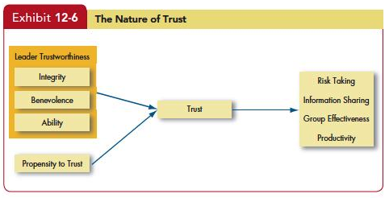
Define authentic leadership and show why effective leaders exemplify ethics and trust
LO 6
1

Slide 39
Define authentic leadership and show why effective leaders exemplify ethics and trust
LO 6
What Are the Consequences of Trust?
Trust Encourages Taking Risks
Trust Facilitates Information Sharing
Trusting Groups Are More effective
Trust Enhances Productivity
1

Slide 40
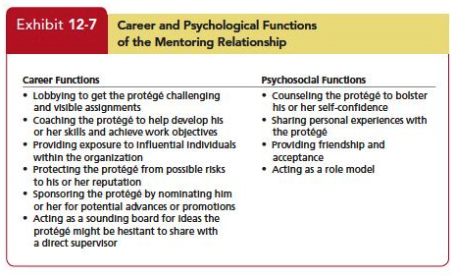
Demonstrate the role mentoring plays in our understanding of leadership
LO 7
1

Slide 41
Demonstrate the role mentoring plays in our understanding of leadership
LO 7
You might assume mentoring is valuable for objective outcomes like compensation and job performance, but research suggests the gains are primarily psychological.
Mentors may be effective not because of the functions they provide, but because of the resources they can obtain.
Most evidence suggests that network ties, whether built through a mentor or not, are a significant predictor of career success.
1

Slide 42
Address challenges to the effectiveness of leadership
LO 8
Much of an organization’s success or failure is due to factors outside the influence of leadership. In many cases, success or failure is just a matter of being in the right or wrong place at a given time.
The attribution theory of leadership says leadership is merely an attribution people make about other individuals.
1

Slide 43
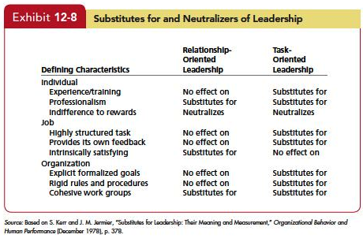
Address challenges to the effectiveness of leadership
LO 8
1

Slide 44
Address challenges to the effectiveness of leadership
LO 8
Online Leadership
Needs research.
Today’s managers and employees are increasingly linked by networks rather than geographic proximity.
Online leaders have to think carefully about what actions they want their digital messages to initiate.
Writing skills are likely to become an extension of interpersonal skills.
1

Slide 45
Address challenges to the effectiveness of leadership
LO 8
Selecting Leaders
Items of consideration during selection include:
Review specific requirements for the position.
Personality tests can identify traits.
High self-monitors are better at reading situations and adjusting.
High emotional intelligence should be an advantage.
Experience is poor predictor of effectiveness.
1

Slide 46
Address challenges to the effectiveness of leadership
LO 8
Training Leaders
Successful with high self-monitors
Train people to develop “an understanding about content themes critical to effective visions.”
Teach skills such as trust building, mentoring, and situational-analysis skills.
Behavioral training can increase an individual’s ability to exhibit charismatic leadership qualities.
Finally, leaders can be trained in transformational leadership skills that have bottom-line results.
1

Slide 47
Summary and Implications for Managers
Knowing what makes a good leader should thus be valuable in improving group performance.
Search for universal leadership traits failed.
Behavioral approach’s contribution was narrowing leadership into task-oriented (initiating structure) and people-oriented (consideration) styles.
Research leadership has contributed to our understanding of leadership effectiveness.
Tests and interviews help identify people with leadership qualities.
1

Slide 48

All rights reserved. No part of this publication may be reproduced, stored in a retrieval system, or transmitted, in any form or by any means, electronic, mechanical, photocopying, recording, or otherwise, without the prior written permission of the publisher. Printed in the United States of America.
Copyright © 2013 Pearson Education, Inc. publishing as Prentice Hall
Notes:
All rights reserved. No part of this publication may be reproduced, stored in a retrieval system, or transmitted, in any form or by any means, electronic, mechanical, photocopying, recording, or otherwise, without the prior written permission of the publisher. Printed in the United States of America.

